Slide 1
Cancer Research UK
Facilitator Programme:
Working in partnership to improve cancer outcomes
Marion O’Neill
March 2017

Slide 2
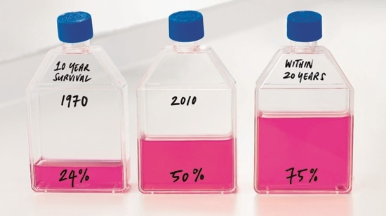
The Facilitator programme
We support healthcare professionals and organisations to improve prevention and early diagnosis.

Slide 3
How we work with the NHS
Influencing uptake of best practice
Relationship managers for the NHS
We work with:
Primary care (general practice, pharmacy, dentists)
Community care
Diagnostics and secondary care
Planners of care
We work with health professionals and health services
Facilitating local solution-finding and innovation
Gathering local intelligence to inform priorities
Spreading innovation

Slide 4
Engagement with health professionals June-Sept 2016
6650 interactions
Average 1662 per month
58%
Face to face

Slide 5
Engagement with health professionals % with different organisations

Slide 6
Engagement with health professionals Themes covered

Slide 7
Developing a partnership approach

Slide 8
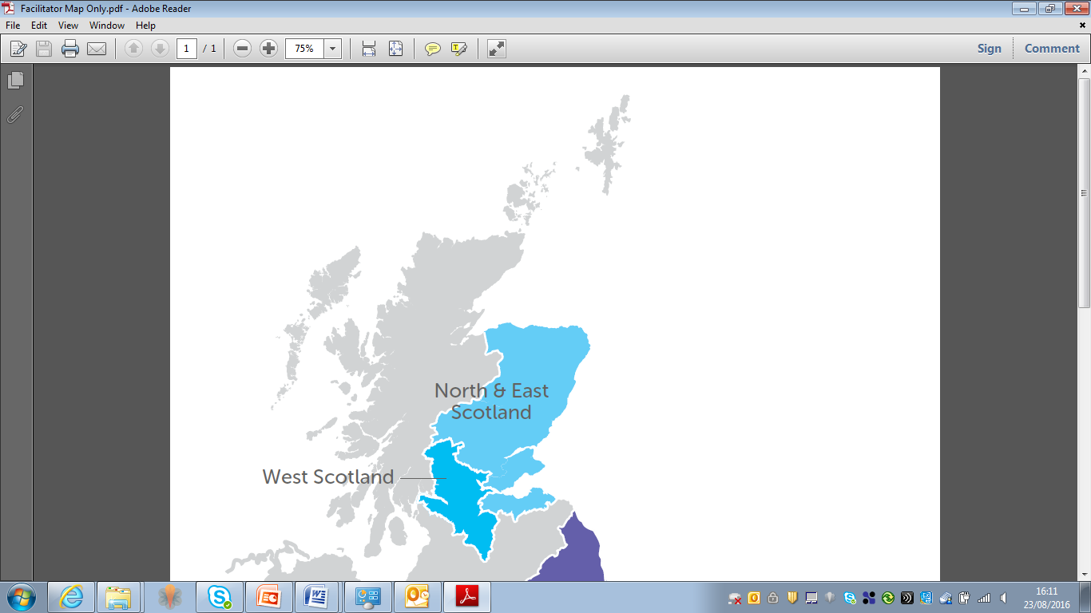
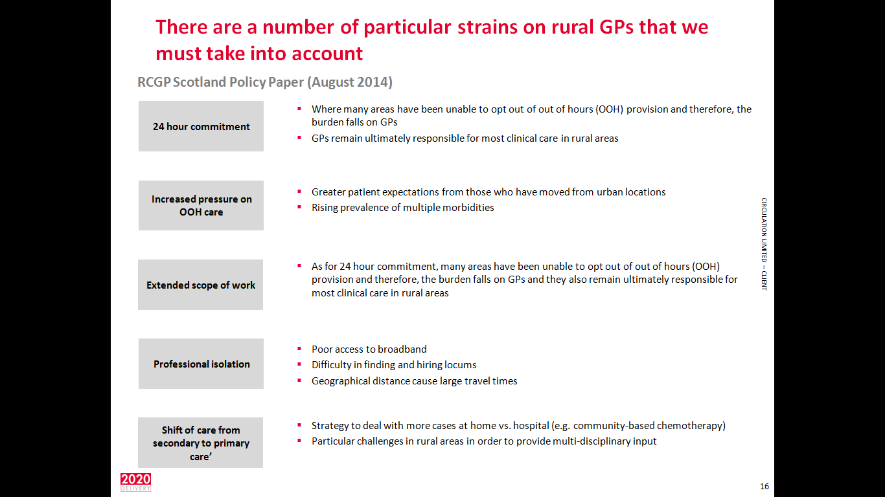
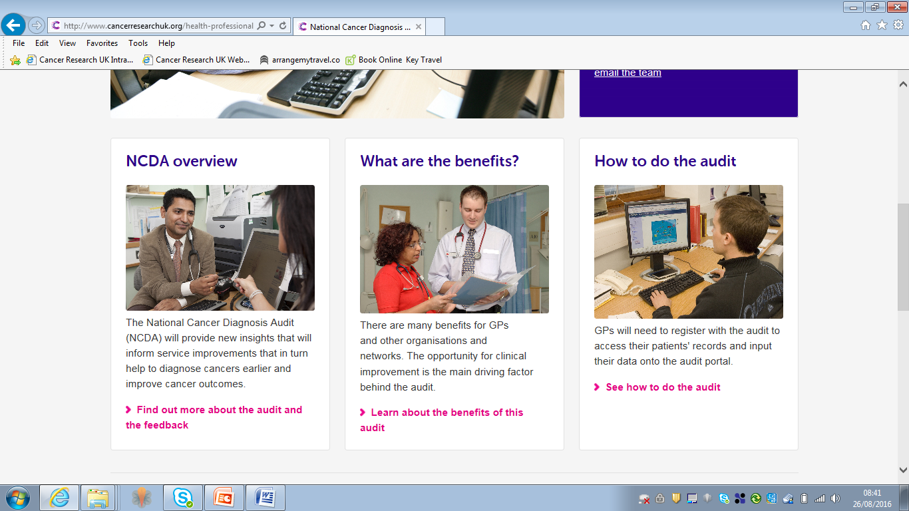
Facilitators
Rural Activity
National Activity

Slide 9
Facilitators
Rural Activity
National Activity

Slide 10
National Cancer Diagnosis Audit
  The audit uses primary and secondary care data relating to patients diagnosed with cancer and will start this year by looking at cases diagnosed in 2014.
  This will help us understand patterns of cancer diagnosis for all cancer types, and give benchmark, so that in time, we can assess the impact of the new referral guidelines.
Audit questions:
  What is the interval length from patient presentation to diagnosis?
  What use is made of investigations prior to referral?
  What are the patients referral pathways?

Slide 11
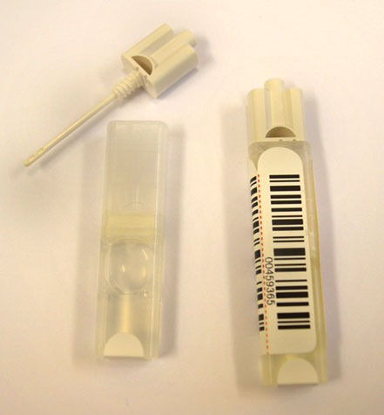
Bowel Screening Programme

Slide 12
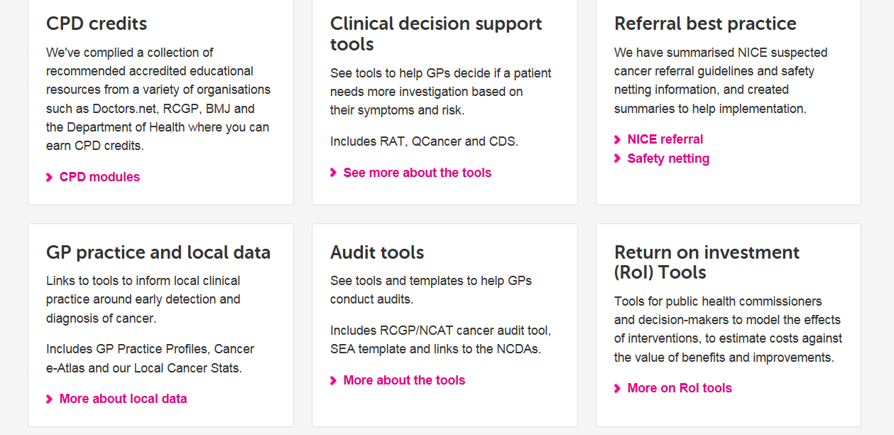
Website: Learning and Development Tools
http://www.cancerresearchuk.org/health-professional/early-diagnosis-activities

Slide 13
Facilitators
Rural Activity
National Activity

Slide 14
Cascade Sessions
Aim: To support and empower cancer champions in primary care
Glasgow, December 2016:
Focused on cancer as a quality improvement topic and National Cancer Diagnosis Audit, specific populations
Rural Communities:
Can you perceive challenges to diagnosing cancer in your practices or area in patients living further away?
Based on your experience do patients from further away receive less input following cancer treatment?
Future Session
Aberdeen, November 2017:
Content tbc
http://www.cancerresearchuk.org/health-professional/early-diagnosis-activities/cascade-workshops/what-is-cascade

Slide 15
Facilitators
Rural Activity
National Activity

Slide 16
Developing positive partnerships
Formal Partnership Agreement
Input to recruitment process
Clear Workplan
Joint
induction
programme
Regular Meetings
Flexibility in approach

Slide 17
Partnership
Products

Slide 18
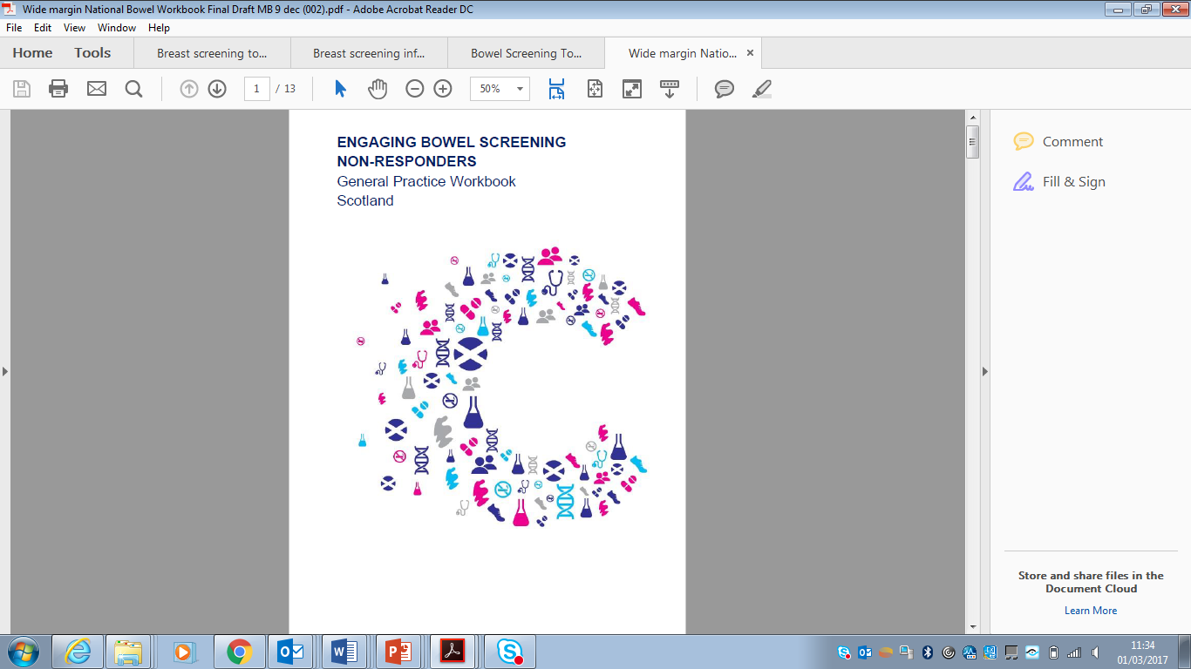
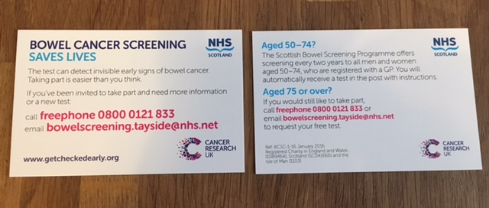
Bowel Screening

Slide 19
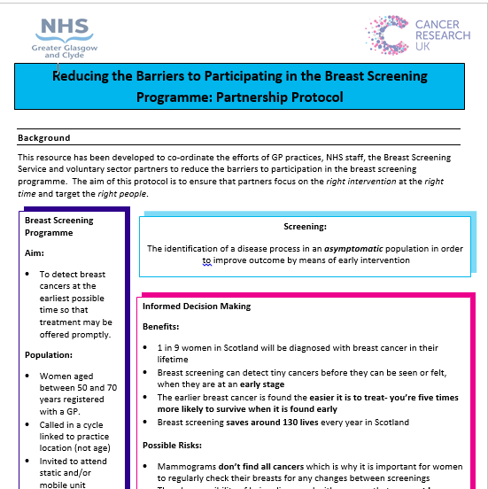
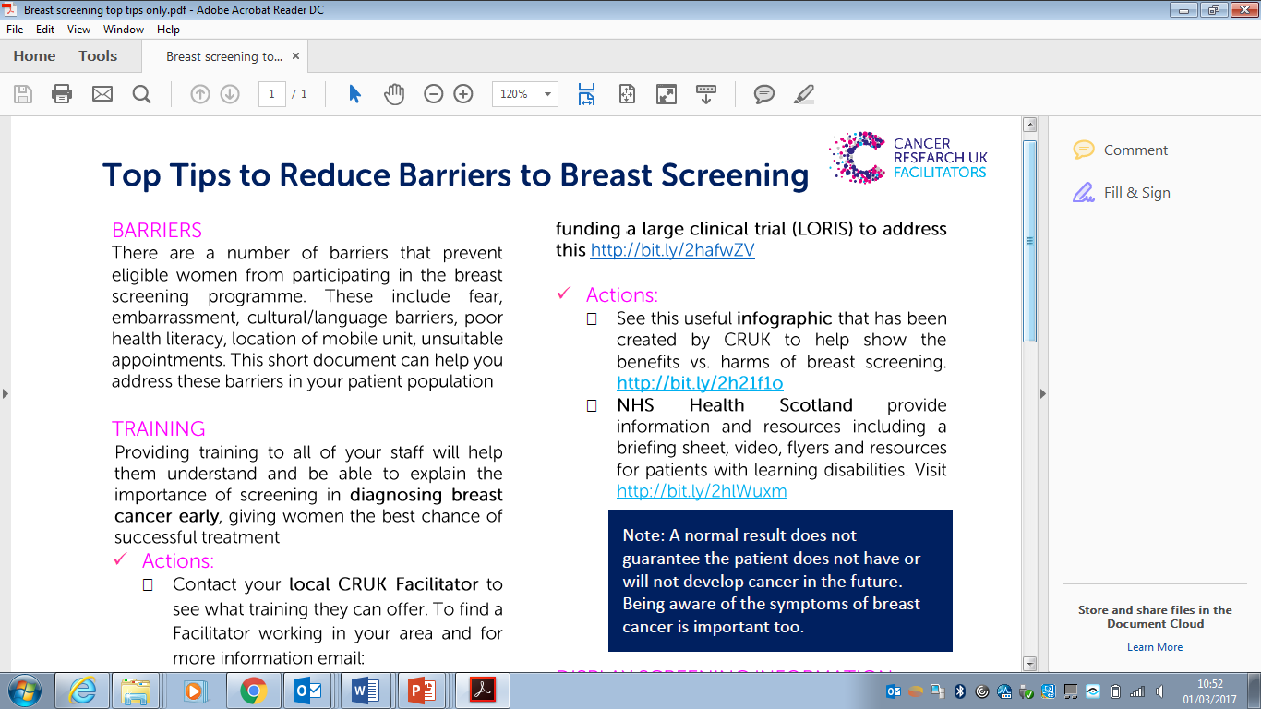
Breast Screening

Slide 20
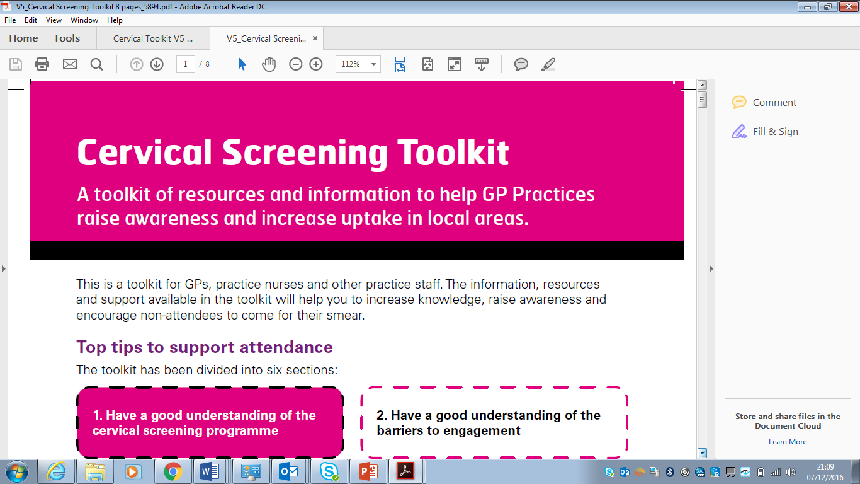
Cervical Screening

Slide 21
Partnership
Proposals:
Patient/
Public

Slide 22




MARKETING CAMPAIGNS
Long -term advertising campaign in 7 regions of england:
Lancashire
Merseyside
Manchester
North east
Yorkshire
Leicester
South
X4 bursts of outdoor and regional press advertising
Aug 15 – apr 16
Results due 2017
North West only
11% increase in awareness of bowel screening programme from pre to post
Campaign
recognition: 41%
All other regions

Slide 23
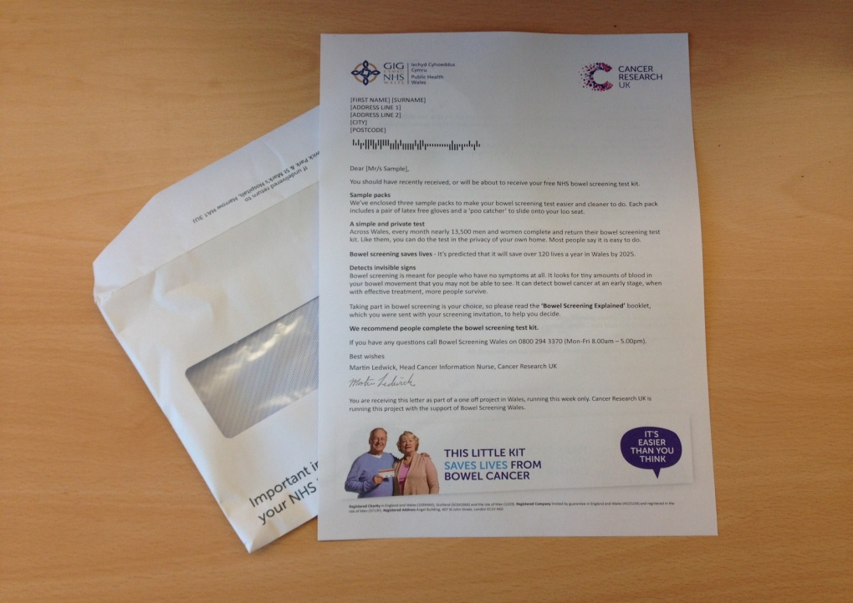
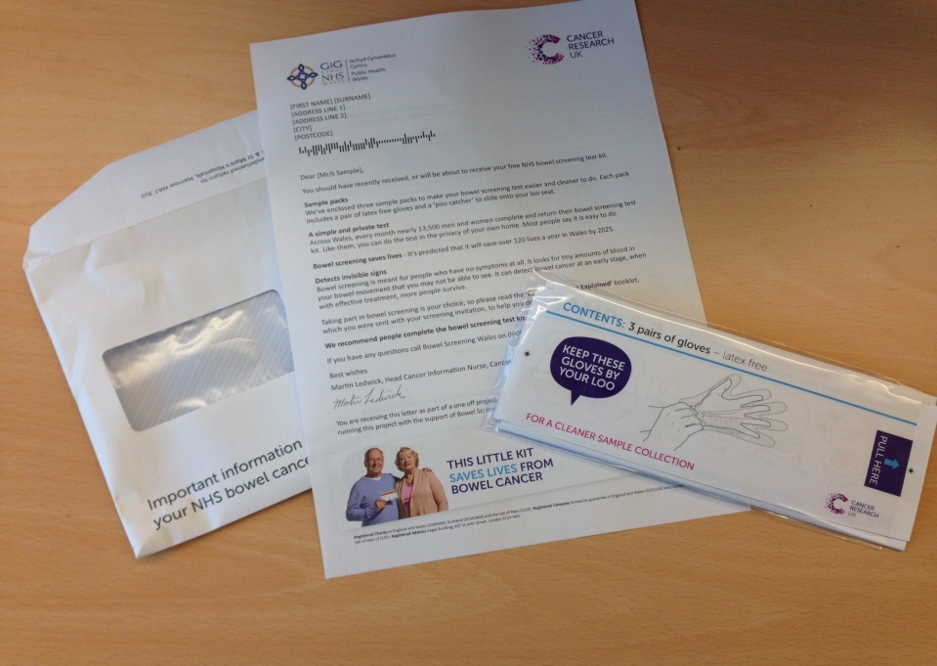
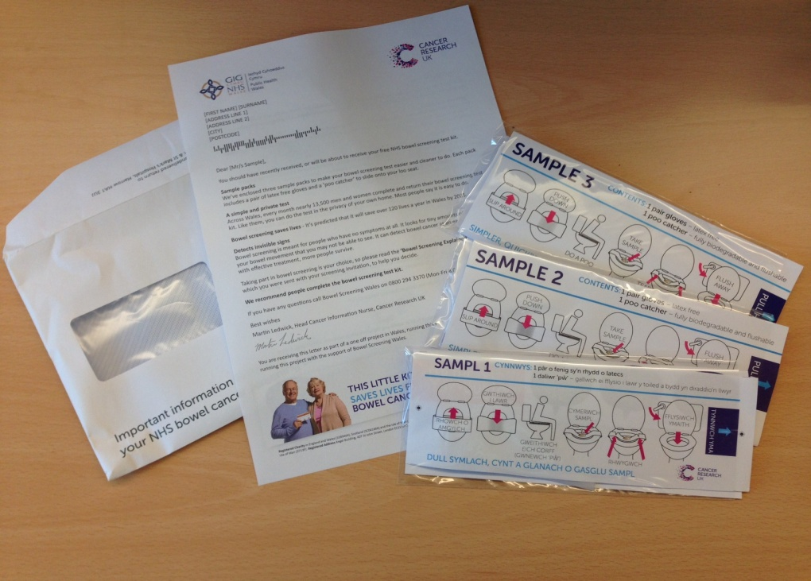

DIRECT MAILING (NATIONAL OR BOARD LEVEL)
A. Endorsement letter | B. Letter + pack with gloves
C. Endorsement flyer + pack with gloves & poo catcher | D. Advertising only
Largest impact among
First Timers
+9.1% increase
Largest impact among
Non-Responders +2.6% increase
+
No significant impact on uptake
Significant decrease among ‘Previously Screened’
-1.6% decrease
Significant impact among
Non-Responders
+2.4% increase

Slide 24
Partnership
Proposals:
Health Professionals

Slide 25
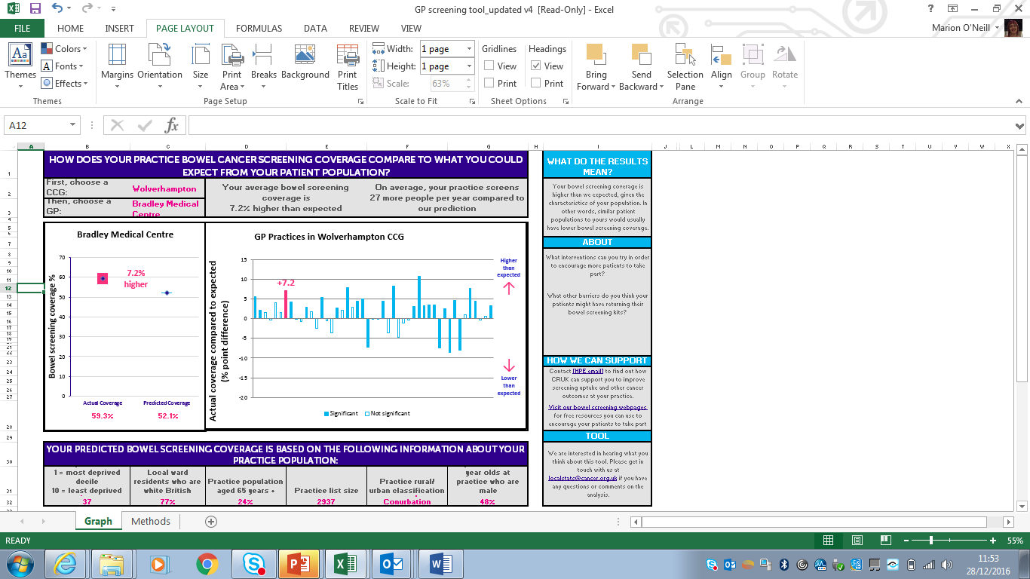
Screening: actual v expected uptake

Slide 26
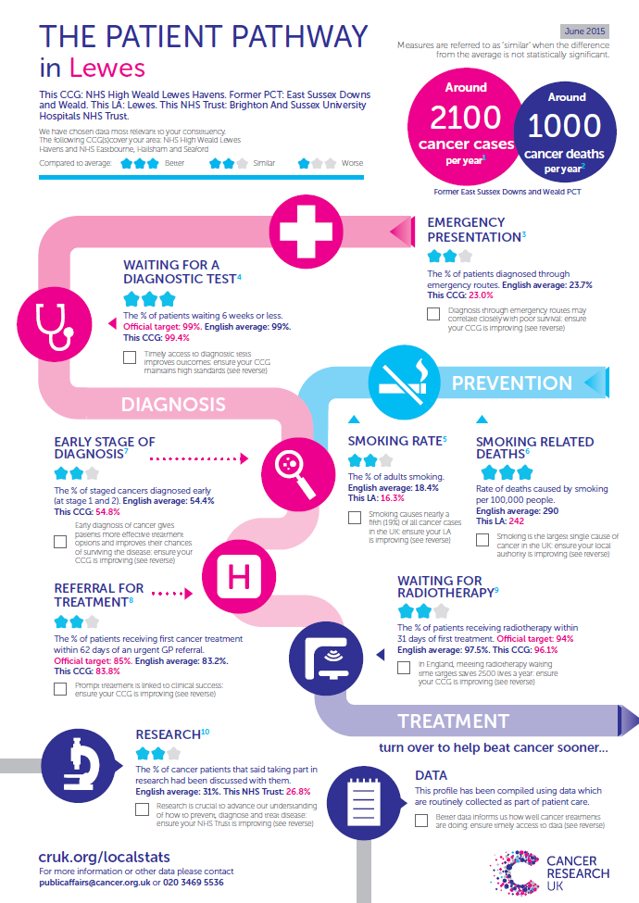
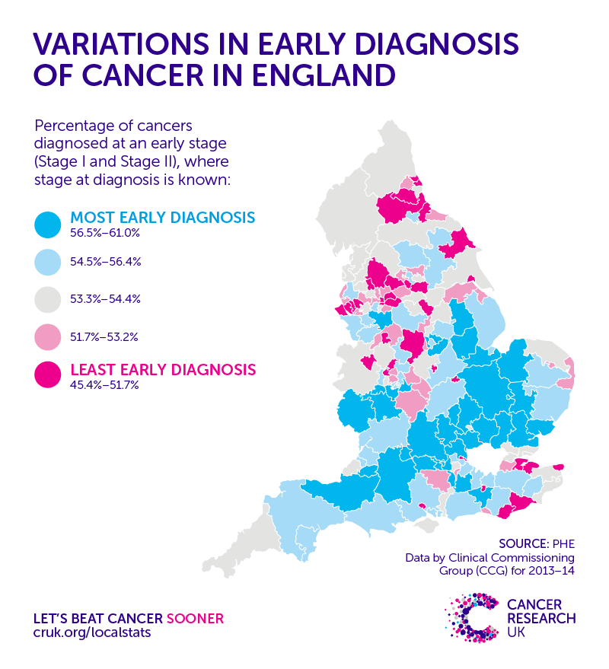

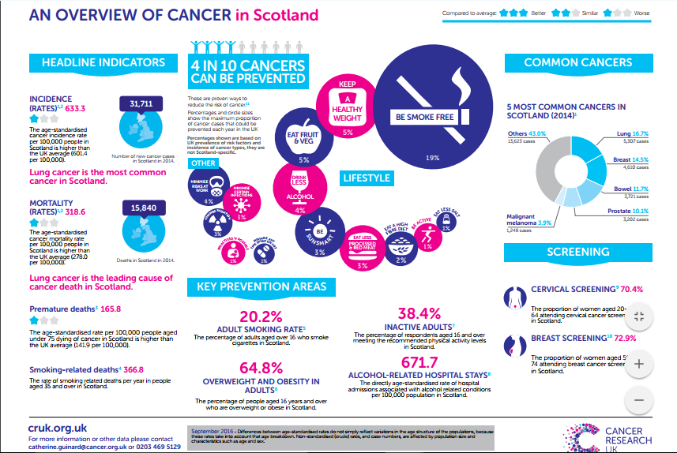
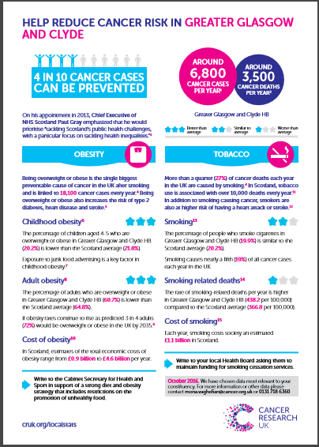
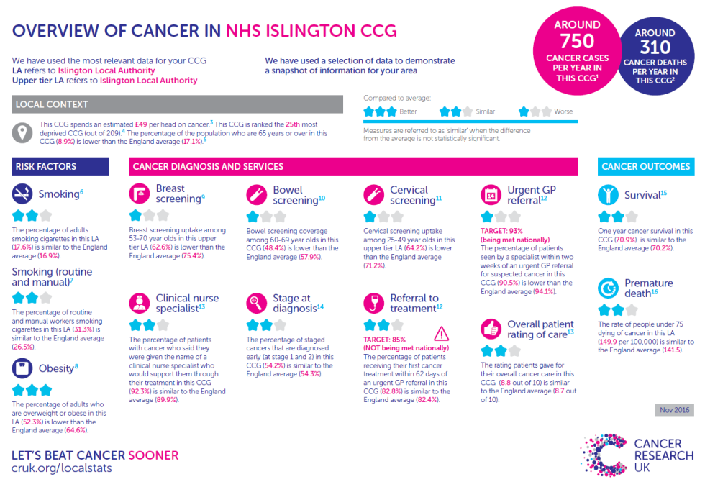

Intel. Translation and presentation

Slide 27
Further information:
Marion O’Neill
Regional Manager (Devolved Nations)
marion.o’neill@cancer.org.uk
07467 336 544

