Slide 1
Primary Care Role in Cancer Screening & Inequalities Dr Lorna Porteous, GP Lead for Cancer, NHS Lothian March 14th 2017

Slide 2
DETECT CANCER EARLY
Programme launched in February 2012 by the Cabinet Secretary
Whole systems approach to improving outcomes through diagnosis and treatment of cancer at the earliest stages.
HEAT (Health, Efficiency, Access and Treatment) target to increase the proportion of people diagnosed with stage 1 bowel, breast and lung cancers by 25% by the end of 2015.
Reduce differences in cancer survival rates between most and least affluent areas.

Slide 3
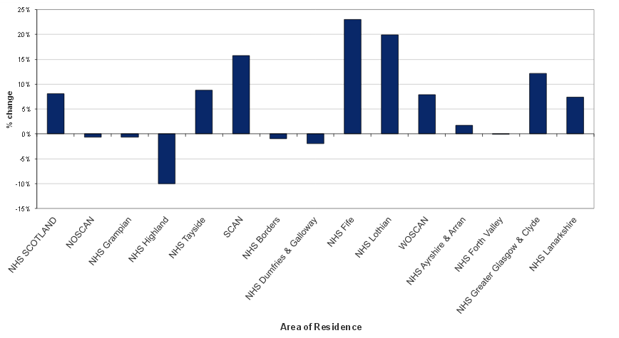
HEAT Success in Lothian – 20% baseline change
Source: ISD July 2016 – combined 2014/15 data

Slide 4
Contribution of stage 1 breast, colorectal and lung to HEAT performance
Source: ISD July 2016

Slide 5
National Drivers - sGMS contract initiative
2 year GMS contract initiative in Bowel Screening (sQOF)
Lothian results, 104/125 practices took part
Year 1 % reduction in non response
91% reached >4.1%
Max of 19.9%
Mean of 8.1%
Year 2 Bowel Screening uptake rates
% Uptake 2008-10 2010-12 2012-14
Lothian 50.8 53.5 57.0
Scotland 53.7 54.9 57.6
Difference 2.9 1.4 0.6
(% point)

Slide 6
Targeted approach to address inequality
Cancer Stage (combined breast, colorectal and lung) | NHS Lothian SIMD Quintile
 | 1 - most deprived | 2 | 3 | 4 | 5 = least deprived
Stage 1 | 24% | 23% | 29% | 29% | 33%
Stage 2 | 27% | 25% | 26% | 26% | 29%
Stage 3 | 19% | 20% | 17% | 17% | 13%
Stage 4 | 25% | 26% | 23% | 23% | 20%
Stage Not Known | 5% | 5% | 5% | 5% | 4%
Source: ISD July 2016 - combined 2014/15 data

Slide 7
2017/18 – Beating Cancer in Scotland: Ambition and Action
Cancer Screening – Raising awareness in target audiences
Local promotional work to support national cervical, breast and bowel public awareness campaigns
Example: Looking at bowel and cervical screening uptake in 8 most deprived practices
QFIT and Cervical Updates for staff

Slide 8
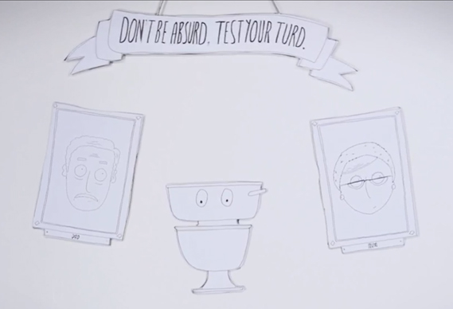
https://vimeo.com/135994229
(copy and paste in to firefox)

