Slide 1
Improving the reach of the cervical screening programme
Robert Music
Chief Executive
Notes:
1

Slide 2
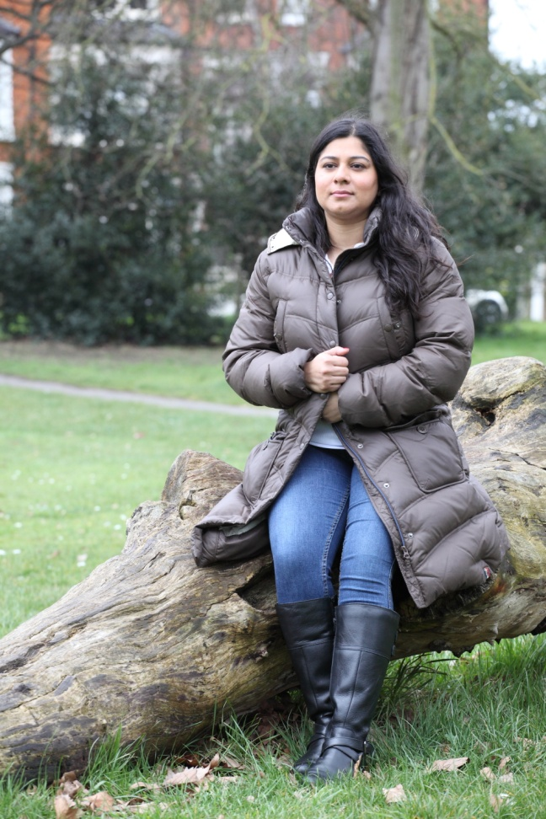
The impact of cervical cancer
“As long as I can remember I had wanted children and the most distressing part of this illness is that I will never be able to.”
“I've got radiation damage to my bowel and its getting to the stage that i no longer go out if I can't help it.”
“If only I had gone for my regular screening, perhaps things would be different now.”

Slide 3
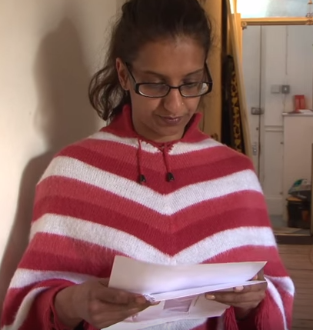
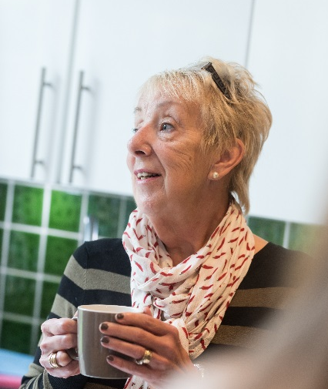
Barriers and non attenders
Accessibility
Embarrassment
Health literacy
Time to attend
Fear
Knowledge
Relevance
Women from Minority Ethnic communities
Women with learning disabilities
Younger women (first age of screening)
Over 50s
Women from social deprived areas

Slide 4
Barriers and non attenders
Health literacy
Knowledge
Relevance
Women from Minority Ethnic communities
Women with learning disabilities
Women from social deprived areas

Slide 5
Resources for women from BAME communities

Slide 6
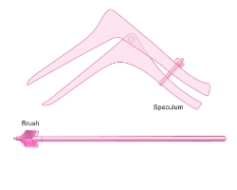
Ethnicity and its influence on screening
Understanding the role of screening
You Gov survey
Socio-economic factors deprivation
Health
Functional (LLN) and making sense and applying
English as a second language
Informal data from local screening programmes

Slide 7
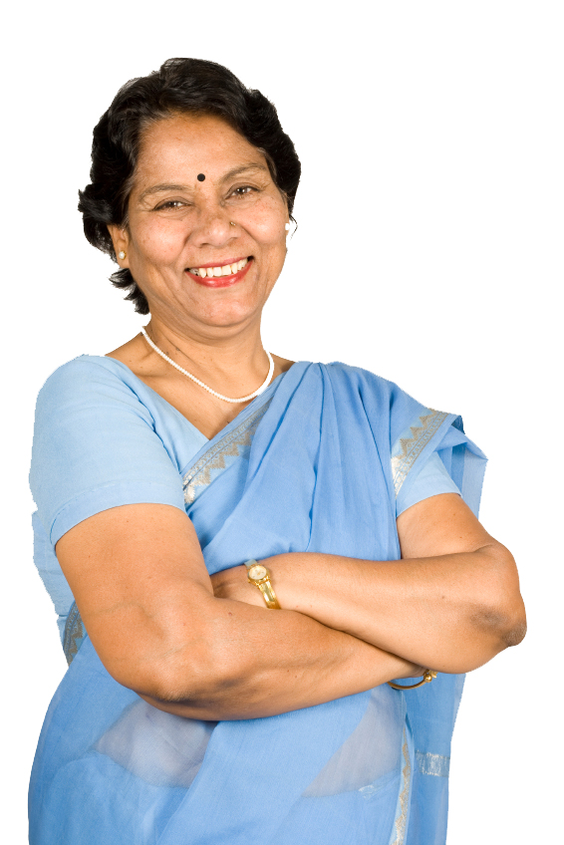
Ethnicity and cervical screening
1/3rd more BAME women of screening age compared to white women said they had never attended a cervical screening appointment
Four times as many BAME women as white women said “It did not seem relevant to me”
Screening is a test to check cells from the cervix to find pre-cancerous abnormalities
91% white women agreed v 78% BAME women
Just 70% Asian women

Slide 8
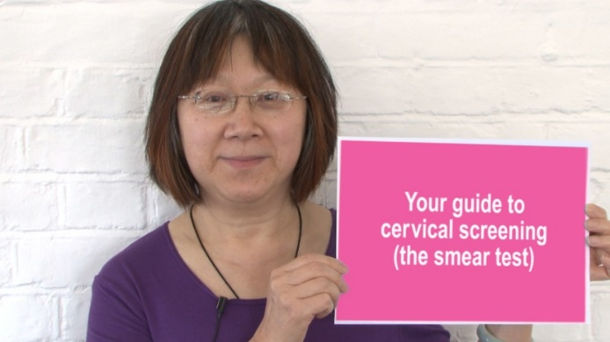
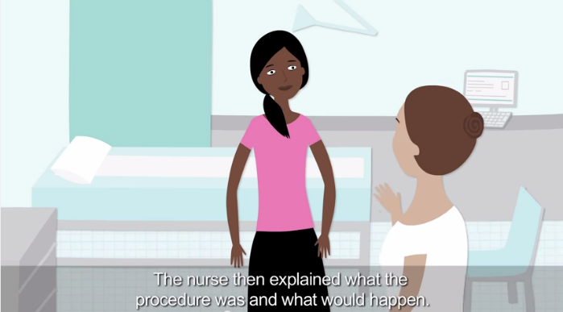
Resources BAME women wanted
Collaboration with health literacy groups
Focus groups and 3 phases
Focus groups showed issues around understanding
Helped us sense check language & images
Identified real women should feature in the resource

Slide 9
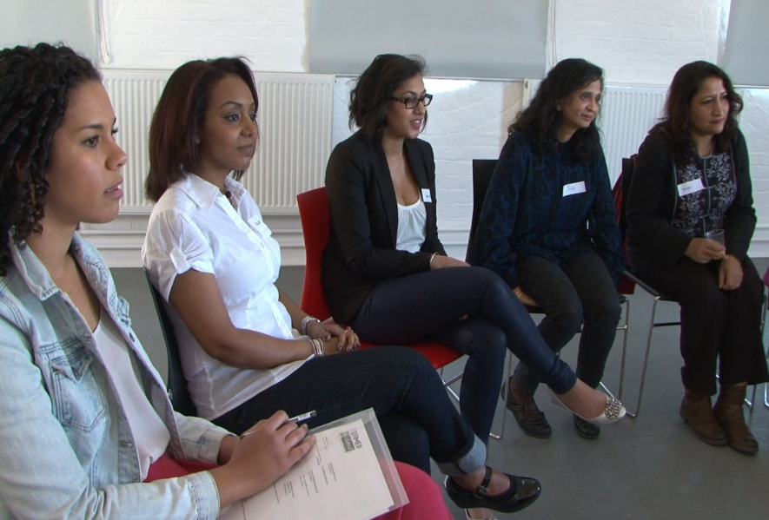
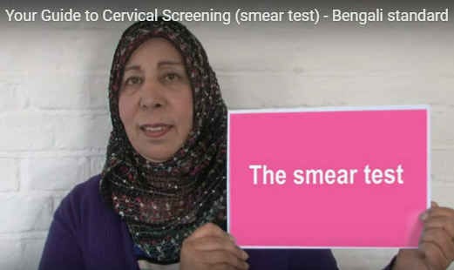
Your guide to cervical screening:
Views to date:
Translations – 80,000
English – 34,000
Well received
Next steps = still new product
learning
use as part of our outreach expansion
Evaluate

Slide 10
Producing resources for women with a learning disability

Slide 11
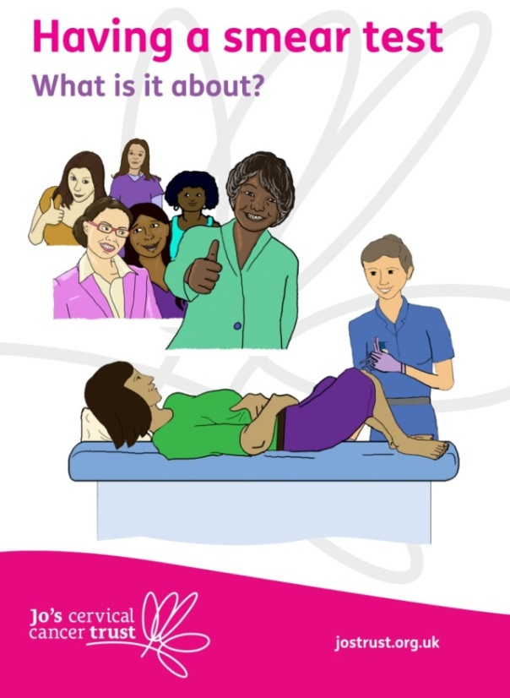
Women with a learning disability (LD)
People with LD 45% less likely to attend cancer screening
Women with LD only 25% take up cervical screening compared to 78% general population
Health inequalities
Needed new and relevant resources: now we have an EasyRead and film

Slide 12
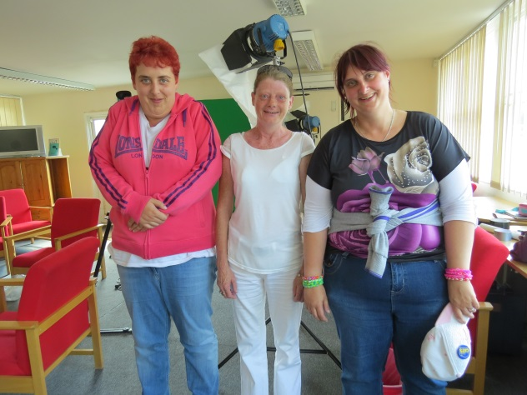
Smear Test Film – a partnership
PHE Bristol, North Somerset, Somerset & South Gloucestershire brought together a working group
Lead by Screening & Imms Lead
Public health specialists
A health psychologist
Jo’s Cervical Cancer Trust
LD nurses
Most importantly women with LD
Local to national

Slide 13
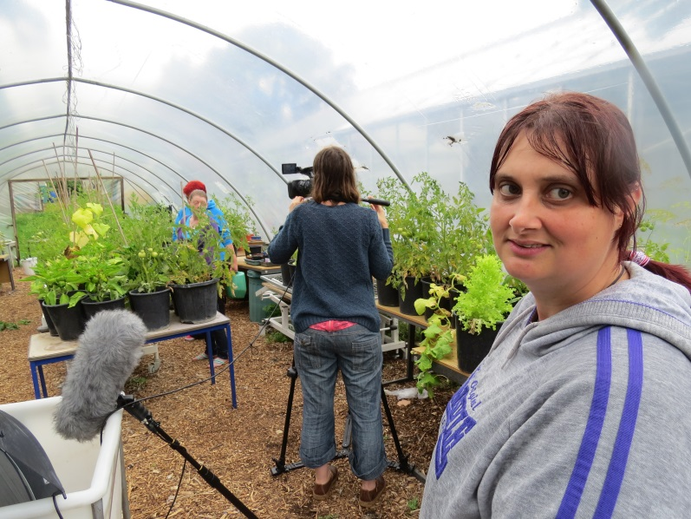
National
Film distribution
Your tube views on Jo’s Trust channel: 11,927
DVDs distributed: 600
99% of orders have been received from HCPs to train others or show directly to women with LD
GP practices and Learning Disability Liaison Nurses

Slide 14
Feedback
64% said film has aided women with an LD to make a decision about cervical screening attendance.
14% seen an increase in numbers of women with an LD attending cervical screening since they showed the film.
“…I showed the film to a group of people with LD and they thought it was fantastic. It was the first time they had seen such an appropriate resource and I have been invited back to do the session to a different group & carers.”

Slide 15
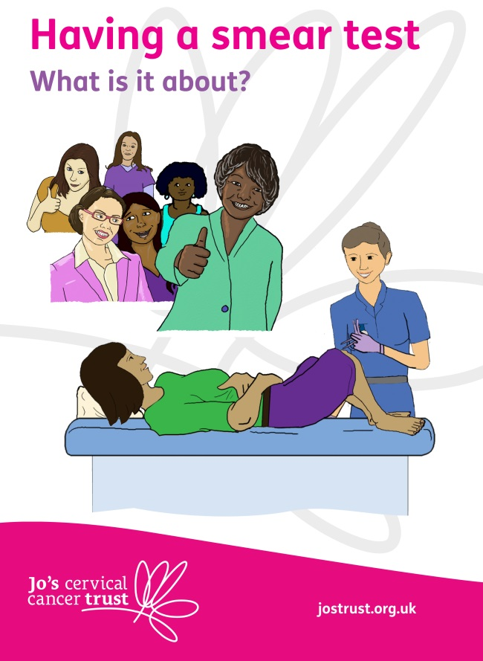
Making the Easy Read guide
Four focus groups took part:
Asked about the words they use for cervical screening, their body, and the barriers to attending screening for LD women
At first draft commented on illustrations, language and layout

Slide 16
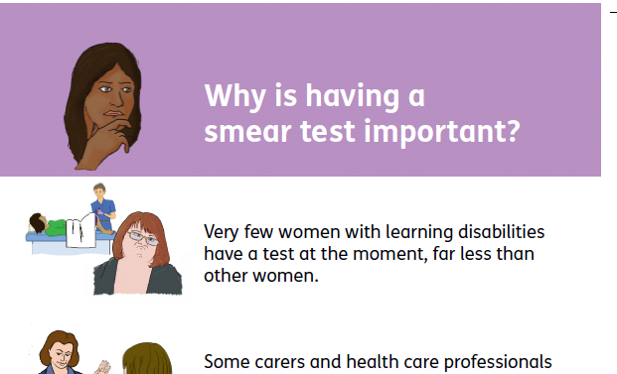
Feedback
100% of guides are ordered by health care professionals
“Organised a workshop for women with LD to attend in partnership with some local GP practices. 1 lady booked an appointment to have screening completed.”
8% noticed a change in the number of women with LD attending cervical screening since using the guide

Slide 17
Working with communities to increase uptake

Slide 18
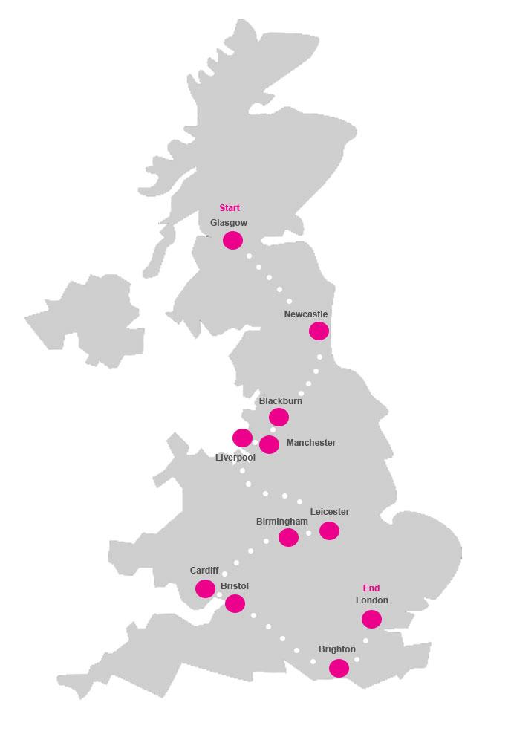
Be Cervix Savvy Roadshow
Engage with 100 people each day – over 4000 in total
Distribute over 10,000 information materials
Help people reduce their risk of cervical cancer
Talk about:
What cervical screening is, what to expect at the test and the role of it in preventing cervical cancer
About cervical cancer and how to spot the symptoms
Who can have the HPV vaccine and why

Slide 19
Where will we go?
Week starting | Where to find us
20 March | Glasgow
27 March | Glasgow
3 April | Newcastle
10 April | Blackburn
18 April | Manchester
24 April | Liverpool
1 May | Leicester
8 May | Birmingham
15 May | Cardiff
22 May | Bristol
29 May | Brighton
5 June | London
12 June | London
19 June | London

Slide 20
Where will we go?
Week starting | Where to find us
20 March | Glasgow
27 March | Glasgow
3 April | Newcastle
10 April | Blackburn
18 April | Manchester
24 April | Liverpool
1 May | Leicester
8 May | Birmingham
15 May | Cardiff
22 May | Bristol
29 May | Brighton
5 June | London
12 June | London
19 June | London

Slide 21
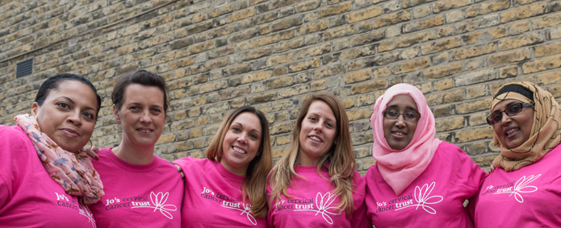
‘Beating Cancer: Ambition and Action’
To encourage and support people to reduce their risk of cancer by living healthier lives,
focusing on reducing health inequalities’:
Application Scottish Government

Slide 22
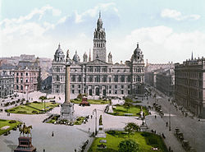
Glasgow Outreach Service
Application was successful!!!
Provide targeted education to women from hard to reach groups in Glasgow
Address health inequalities across Glasgow
Improve access to and uptake of the SCSP
Develop engagement with health professionals and communities in Glasgow
Train 90 health champions – reach 3,600

Slide 23
