Slide 1
Data/Uptake issues specific to screening: Improving reach of our screening programmes – what we know and what we don’t know’
Dr Christine Campbell, University of Edinburgh
Christine.Campbell@ed.ac.uk
Screening and Inequalities Event
March 14th 2017

Slide 2
Outline
Data/ update issues relating to screening
Ethnic variation in bowel and breast screening in Scotland (SHELS)
Understanding uptake patterns – learning from the literature
Improving reach of our screening programmes- what we know and don’t know
Review of some recent evidence
Research gaps and priorities
Concluding thoughts

Slide 3
Scottish Health Ethnicity Linkage (SHELS)
Multi-phase programme of work ongoing since 2003 to provide health-related data by ethnicity
Links the 2001 Census (self-reported ethnicity & socio- demographic data), with hospitalisation, mortality and other health datasets
SHELS has anonymised data on 4.65 million individuals
SHELS-4: All-cause mortality, all-cause hospitalisation, infectious diseases, accidents and bowel cancer screening.

Slide 4
Bowel Screening : SHELS approach
Bowel Cancer Screening database
Census Database
Record Linkage
Encrypted CHI Number
Personal Identifiers
Personal Identifiers
Encrypted Census Number
Encrypted CHI Number
Encrypted Census Number
(Look-up Table)
Screening participation
Ethnicity Information
Dataset

Slide 5
Demographics/Linkage
Data available for 4.65 million individuals, i.e. about 92% of the 2001 population
Ethnicity distribution in Census 2001
Linkage rate of Bowel Screening data to Census 2001 :
86%
Ethnicity | N | Percentage
White Scottish | 4088127 | 88.6%
Other White British | 334983 | 7.3%
White Irish | 43503 | 0.9%
Other White | 65655 | 1.4%
Any mixed background | 11109 | 0.2%
Indian | 12336 | 0.3%
Pakistani | 25631 | 0.6%
Other South Asian | 6512 | 0.1%
African origin | 6333 | 0.1%
Chinese | 13204 | 0.3%
All Other Ethnic group | 7713 | 0.2%
TOTAL | 4615106 | 100.0%
≈ 2%
Data/Outcome size :
1,658,585 individuals

Slide 6
Bowel screening
Results not yet published / in public domain so censored from presentation
Clear variation in screening participation by ethnic group in Scotland
In the main, patterns reflect recognised cultural barriers although also unexpected patterns
Educational interventions among ethnic minority populations need to acknowledge lower CRC rates while also addressing relevant barriers and facilitators

Slide 7
Breast cancer screening (Bansal et al Br J Cancer 2012 Mar 13)

Slide 8
Breast screening - reflections
We know that traditionally lower breast cancer rates in South Asian groups are converging towards the risks in the White UK population, and breast cancer incidence is increasing overall
Limited data on breast screening participation of more recent migrant populations (although emerging data on Polish community, e.g. Gorman and Stoker, 2015)
Breast screening services and information provision have changed over the last decade, and there have been many local and national initiatives – the impact by ethnic group poorly understood

Slide 9
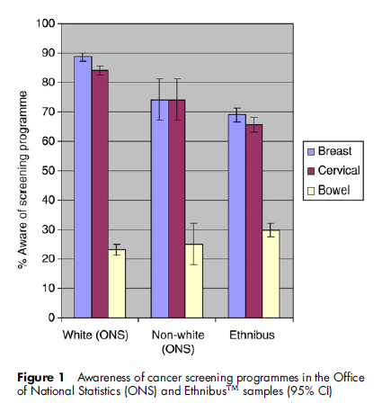
Understanding uptake patterns – learning from the literature (1)
Ethnic disparities in knowledge of cancer screening programmes in the UK (Robb et al 2010)
Used the Cancer Awareness Measure (CAM)
2216 adults, population-representative sampling
An additional 1500 adults using the Ethnibus™ sample

Slide 10
Understanding uptake patterns – learning from the literature (2)
Qualitative work among three South Asian faith communities in England highlighted common barriers: limitations of written English or any written communication; reliance on younger family members; low awareness of colorectal cancer and screening; difficulties associated with faeces (Palmer et al 2015)
Focus groups with ethnic minority groups found limited awareness of screening, anxiety about the invasiveness of the test, the bowel preparation and fear of a cancer diagnosis (Austin et al 2009)
Similar lack of awareness of screening, lack of understanding of screening terms, emotional, practical and low perceived risk found wrt cervical cancer (Marlow et al 2015)

Slide 11
Improving the reach of our screening programmes- what we know and don’t know

Slide 12
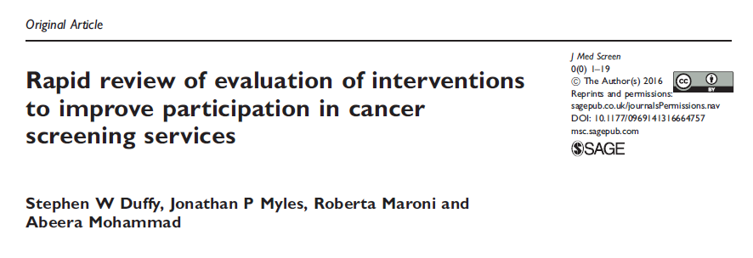
Review of some recent evidence (1)
From the DH Policy Unit in England
Reviewed evidence from 68 research papers
Interventions which consistently improved participation in screening:
Pre-screening reminders (consistent with Libby et al 2011)
General practice endorsement
Personalised reminders to non-respondents
More acceptable screening tests

Slide 13
Review of some recent evidence (2)
Browers et al Implementation Science 2011

Slide 14
Screening: what is the role of primary care?
Supporting patients making decision
Engagement with Screening Programmes and Public Health
Information provision
Provision of screening - cervical
Engagement with and advocacy for local communities
Primary Care & Cancer Screening
Reassurance and support after positive result
Assessment and referral of screen-negative patients with symptoms
Engagement with non-responders
Support after cancer diagnosis
Research to inform future policies

Slide 15
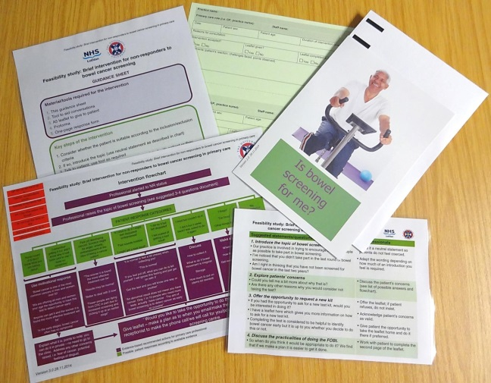
Feasibility study of a brief primary care intervention in routine consultations with non-responders
NAEDI-funded research study, in Lothian
3-4 suggested questions/topics exploring patients’ non-participation in bowel screening
Provision of a patient information leaflet addressing common concerns regarding bowel screening, and details of how to contact the SBSC to request a new FOBt kit (phone, email or freepost)
Supplementary flowchart for professionals with potential patient concerns and evidence-based suggestions for dealing with them
Recruited practices | Uptake % (2013) | Pop 50-75 | Mean SIMD decile (50-75 year olds) | Average monthly non-responders
A (Edinburgh) | <45% | 1,413 | 2.6 | 41
B (Edinburgh) | 45-50% | 2,654 | 3.6 | 61
C (East Lothian) | 50-55% | 2,515 | 4.5 | 56
D (Edinburgh) | 50-55% | 1,241 | 6.2 | 29
E (Midlothian) | 55-60% | 1,668 | 5.5 | 30

Slide 16
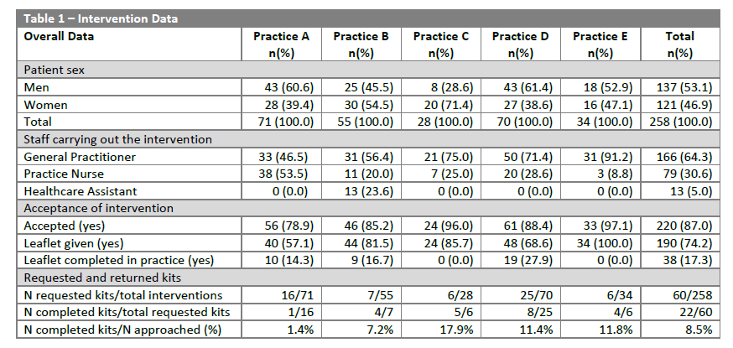

Slide 17
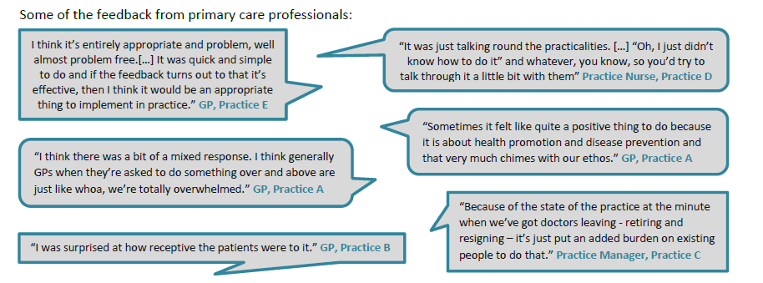
Patients were largely receptive to being approached about their non-participation in bowel screening
Intervention found to be largely acceptable, simple and easy to administer in practice – and in line with the primary care professionals’ roles
Pressurised work environment impacted ability to deliver intervention
If integrated into existing IT systems has the potential as a tool to complement other efforts to engage with non-responders
Now similar DCE initiatives – need to be evaluated

Slide 18
Ongoing research in the UK
Understanding bowel, breast and cervical screening patterns
Interventions including narrative-based, GP endorsements, specialist screening practitioners
Developing specialised materials for ‘hard to reach’ groups

Slide 19
Research gaps and priorities
Ongoing need to find effective interventions to address inequalities (particularly socio-economic, and gender for bowel screening) in all screening programmes
Falling uptake particularly among younger women, and not always driven by deprivation
Communication – ensuring informed choice, incorporating best evidence regarding over-diagnosis, and communication of risk (and the role of primary care in supporting individuals understand personal risk)
Better understand the experience of screening, acting as facilitator or barrier to future participation, especially cervical screening
Obesity – recent meta-analysis shows obesity is weakly associated with increased risk of cervical cancer, but also acts as barrier to participation
HPV self-sampling – need for better understanding of how it might fit with the national programme

Slide 20
Conclusions
We need to implement the evidence we already have – no one approach sufficient but incrementally are worthwhile
Prioritisation of screening interventions through the Detect Cancer Early initiative and through Cancer Research UK Primary Facilitator, Jo’s trust etc approaches are important, but need to be sustained
Introduction of FIT has the potential to change bowel screening participation greatly
Do we need an RCT of HPV self-sampling of non-respondents in Scotland?
Targetted and local interventions are critical to reach disadvantaged groups such as disabled, travellers, immigrants populations

