Slide 1


Macmillan’s Move More Programme

Slide 2


Slide 3
MoveMore is a behaviour change intervention
Based on NICE Public Health Guidance 49 : Behaviour change - individual approach.
Key recommendations include:
Deliver very brief, brief and extended behaviour change interventions and physical activity programmes
Ensure behaviour change is maintained for at least a year by ensuring they receive feedback and monitoring at regular intervals
Macmillan invested £6 million 2012-2018 in MoveMore Intervention throughout Scotland, England Northern Ireland and Wales

Slide 4
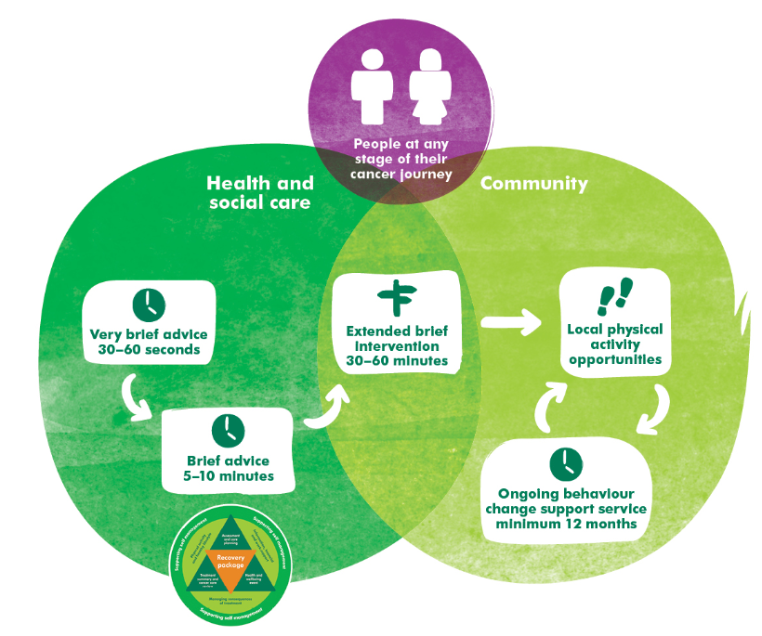

“Everyone living with and beyond cancer is aware of the benefits of physical activity and enabled to choose to become and to stay active at a level that’s right for them”

Slide 6
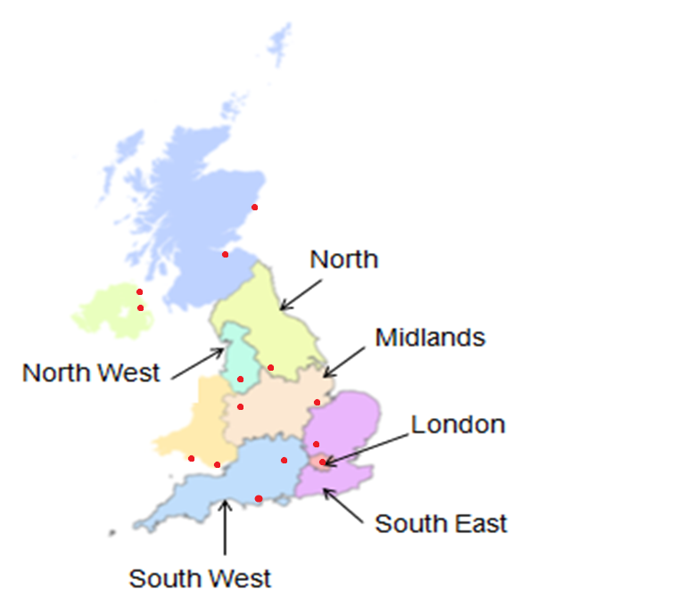
The evaluation (2014-2017)
Phase 1: 6 pilot sites
Phase 2: final total of 14 sites
Quantitative data on outcomes
Ethnographic observations of services
Qualitative interviews with staff, stakeholders and service users
Formative process evaluation
Economic analysis

Slide 7
National Evaluation Methodology
CaPASEF: Outcome Measures
Repeated Measures, Before & After Intervention 3, 6 + 12 month follow up
1. Outcome measures
Levels of Physical Activity | Scottish Physical Activity questionnaire (SPAQ)
Fatigue | FACIT -F
Health Status Quality of Life | EQ5D
Self Efficacy | General Self efficacy questionnaire
2. Demographic and Costs Monitoring and Evaluation
Gender, age, ethnicity, disability, socio-economic status, cancer status, stage of treatment, previous levels of physical activity levels, costs, resources
3. Objective Measure - accelerometer

Slide 8
National Evaluation Methodology
QUALITATIVE METHODS – 168 interviews
Semi structured interviews with 12 service users per service across three sampling points
Interviews with 8 key stakeholders per service exploring how the pathway has been implemented locally
Ethnographic research – qualitative information collected relating to how the services are being delivered and the perceived impact (BECCI tool)
MoveMore practitioners 34
Support staff 26
CNS/Nurse Psychologist General Practitioner physiotherapist 47
Development manager Information manager National programme staff 20
Public Health Sports/Fitness professionals. University staff local Commissioner
Clinical Commissioning Group Hospital Cancer staff Grant/Contract holder
Cancer forum representative Ambassador Volunteer 44

Slide 9
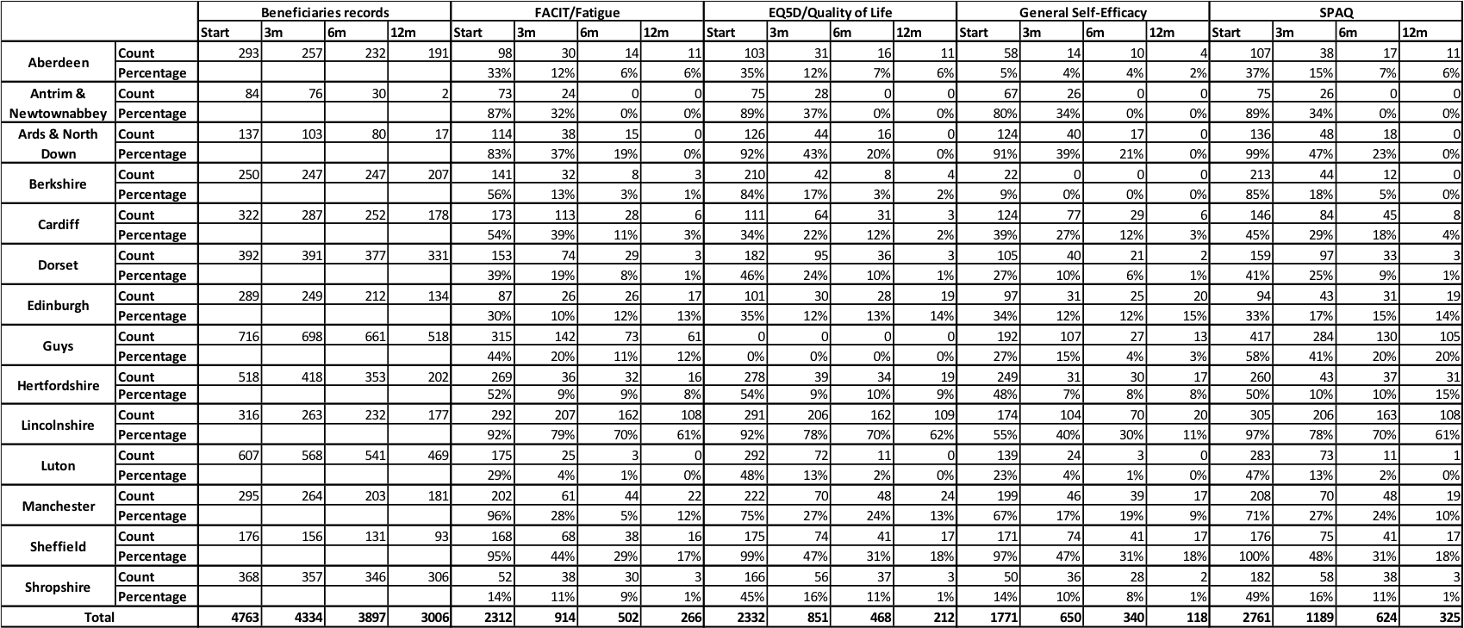
Data Collection Challenges*

Slide 10
Data collection challenges
Poor understanding of purpose of the questionnaire by service users
Move More practitioners had issues with some (socio-demographic) questions and self efficacy questions
SPAQ daunting – yet highest % of usable responses
GSE lower response rates – off putting Q
Evaluation is valid for self completion (and prevents contamination by MM practitioner) and has to be separate from BCI
Follow up data usually by SAE; very few phone calls out of hours; the better the BC follow up the better the follow up data (Lincoln)
One service: Data collection “low priority”, “not sustainable”
Needs to be resourced, on-line better and use of tablets helpful
Many services used data as internal intrinsic part of their service for reports, presentations and to make case for other funds (CCGs)

Slide 11
Raising awareness and generating referrals
Establishing trust with HCP is key to generating referrals
Engagement with HCP needs to be on an ongoing basis
Services embedded in healthcare setting are more likely to generate referrals from HCPs than other settings
HCP that advocate benefits of PA provide the referrals
Feedback to HCP improves referrals as established confidence in the service
Electronic referral best
Very few referrals from primary care setting
Awareness raising techniques generate self referrals

Slide 12
Need for embedded and constant feedback
…two months down the line [referrals] start to drop off again. The engagement isn’t held. We would happily go into a CNS meeting every two or three months, but unfortunately, it’s not that simple. They can’t quite fit us in that often. So, we normally get to a CNS meeting at each hospital, I would say, at least once a year. Move More Practitioner, England
…so we’ve done a little outcome sheet that we’ve devised that just gets scanned in here and sent off through the NHS email. So, the CNSs know that the patient’s been seen or even if the patient’s at least been contacted and what the outcome [is], are they booked in, or have they chosen not to attend…
Service staff member, Shropshire
I think the biggest barrier [to] getting people involved was the referral process because it involved flow charts and forms and emails and things like that. The big step change for us was once it became an electronic referral like everything else. Stakeholder, Velindre (Cardiff)

Slide 13
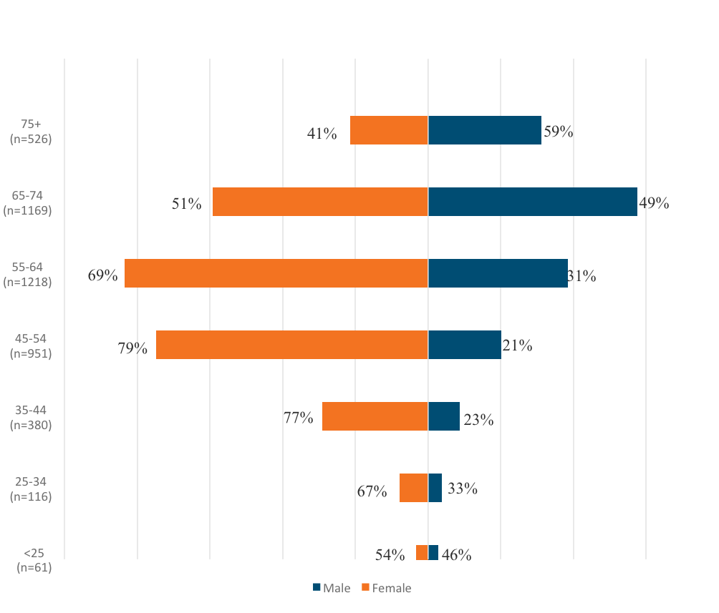

Slide 14
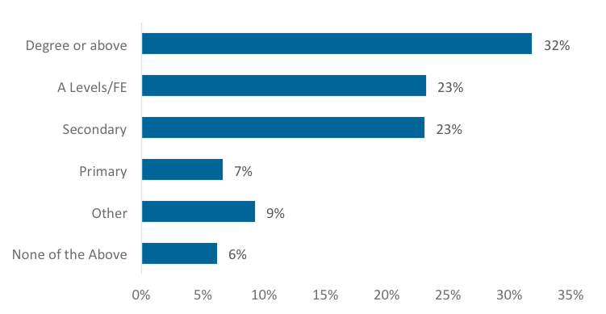
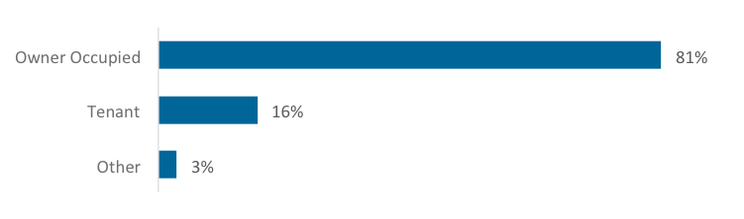

Slide 15
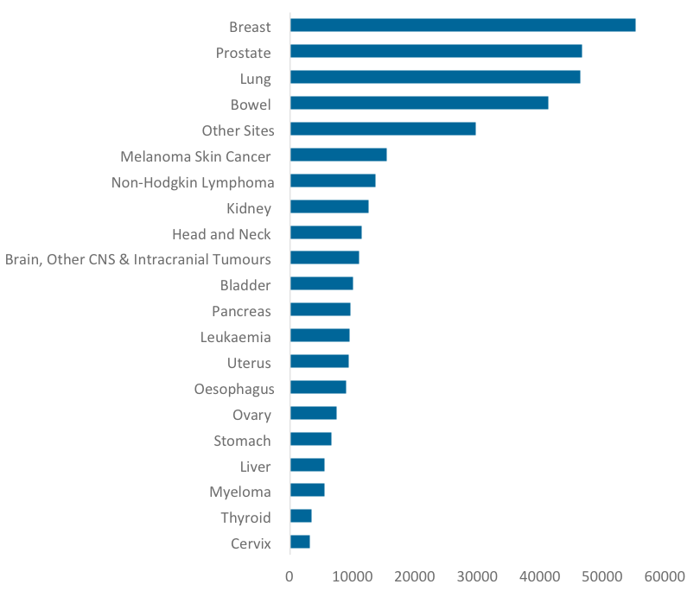
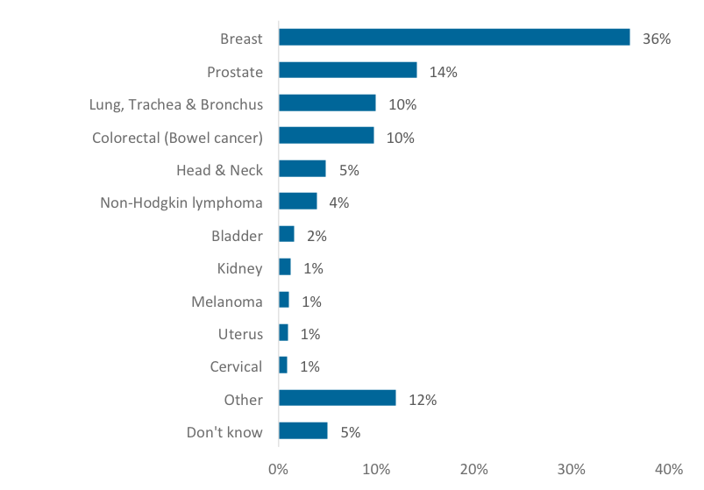
MoveMore Participants
Cancer Incidence

Slide 16
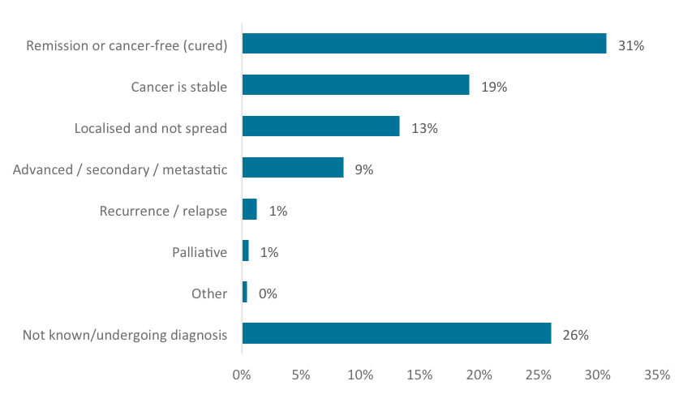
36% post treatment; 25% on treatment; 8% watch and wait;
4% progressive; 2% pretreatment 25% unknown

Slide 17
Behaviour change intervention
Practitioners’ BECCI score*: 22.8 out of 44 (page 80)
“Going through the motions” (in some services)
Closed questions
No summary statements
If a motivated client – assumption was behaviour change intervention not required
Goal setting good (confidence score 1-10)
No true personalised offer
Face to face was better than telephone based approach
Group based BCI – worth considering
Move More practitioner – MI training

Slide 18
Physical activity provision
Direct delivery or signposting
Circuits, gentle movement, walking, gardening, nordic walking, walking football, leisure centre activities, bowls, cycling, challenge events, walking netball, golf, yoga, swimming, cricket, tai chi for health, zumba, dance, running, green gym, back to basketball, gym sessions
Some had no opportunity to continue after set no of sessions; other continued to be free; and others were reduced leisure centre membership
Activities were led by service staff, external instructors, volunteers, Move More practitioners, leisure centre staff
50% of services offered cancer specific classes
Perceived as:
  Safe, qualified instructor, privacy, reduction of barriers, mutual support and improved adherence. Can be replicated at home. But for some – became too easy / boring.

Slide 19
On-going behaviour change support
Service users appreciated support – reassurance
Current delivery model by some services did not allow sufficient resources to provide formal follow up – ad hoc face to face; phone; text; email.
4 services – formal follow up for duration of activity / formal exit interview
Most services – informal support
PA sessions – opportunity to provide support
(The practitioner) did say ‘I’m here if there are any other things or issues that come up, then please let us know,’ and he would see what he could do to support me. Service User, Lincolnshire

Slide 20
Service Management
Where no admin support – Move More practitioner is responsible for raising awareness, BCI, managing referral process (incl appts and follow up) data collection and taking PA classes
Staff training –Best practice - CanRehab qualification whether deliver session or not.
Volunteer training – (walking and gardening programme and buddy at gym) - powerful way to advertise service to PLWC. Core training required
So sometimes you're having to coordinate that across maybe four or five projects, to be able to actually put on one of the training courses. We’re quite keen for that to become more sustainable, so perhaps by having a train the trainer model, where we can get somebody local trained up to be able to deliver that one when we need it. Service Staff, Aberdeen

Slide 21
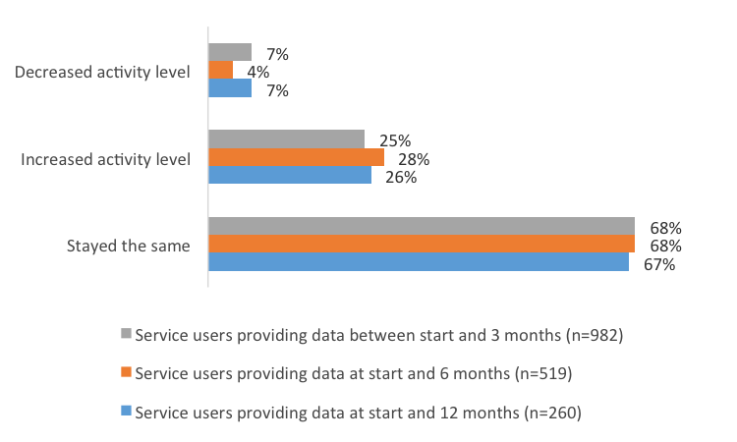
Changes in self report physical activity
Those who provided follow up data -  in PA – by 130 min by 3 months, 34 min at 6 months and 12 minutes by 12 months
Most PA  in early stages of participation
Service users say MM programme speeded up process due to high regard for practitioners

Slide 23
FACIT – Fatigue statistically significant change of 3.29 between start and 12 months (268)

Slide 24

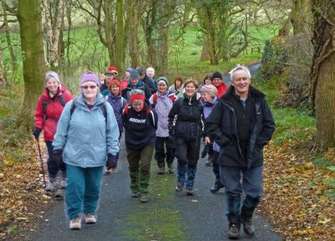

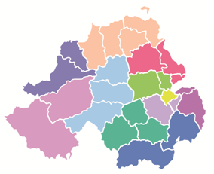
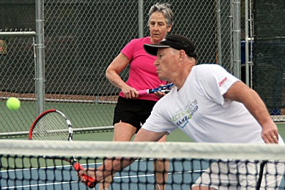
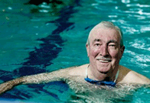











Slide 26
Cost benefit
The evidence of the cost-effectiveness of services is equivocal. The NICE recommended threshold for an intervention to be considered cost effective is £20,000. The cost-per-QALY identified in the evaluation range from £1,109 below the threshold to £29,132 above.
Taking the recommended cost per completer approach results in a mean cost per completer of £291.

Slide 27
Where does Macmillan go from here?
Proposal:
Take time to do the following:
Scotland
Analysis of all data from Scotland Move More programmes
Planning implementation strategy based on current status and recommendations with assistance from Health Scotland
UK wide:
Examine recommendations for all steps - from data management to awareness to referral to BCI to PA offers to service management to outcomes
Influencing and support- i.e Richmond Group of Charities
Embed PA into recovery package, holistic conversations

Slide 28
What have we learned:
– what questions need answered?
To evaluate programme for effectiveness, data collection is important
  What is the minimum dataset required in community based setting?
  How do we ensure it is undertaken effectively?
Referral from clinical setting is vital for success.
  How do we raise awareness and gain the trust of HCP to convince them to refer patients to community program?
  How do we convince it should be standard part of cancer care package?
There is a need for simple referral pathway from clinic to community programmes
  How do we triage and screen patients?
  How do we ensure referral back to clinical setting if necessary
Better MI training

Slide 29
What have we learned:
– what questions need answered?
Motivational Interviewing / Exercise Counseling should be an essential part of the programme
  Who should do this?
Physical activity / exercise programme should include a variety of options including open and closed exercise classes run by fitness instructors with appropriate qualifications
  What qualifications are appropriate for generic/ cancer specific exercise offers?
Clients should be supported for up to one year to encourage behaviour change
  Who should do this?

