Slide 1
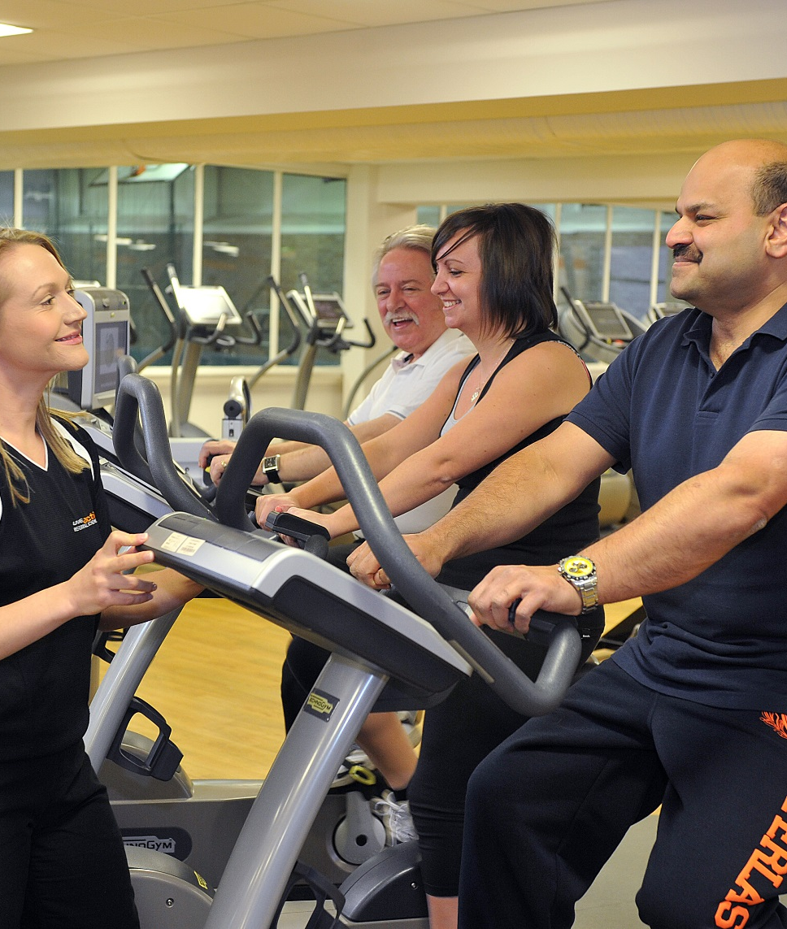

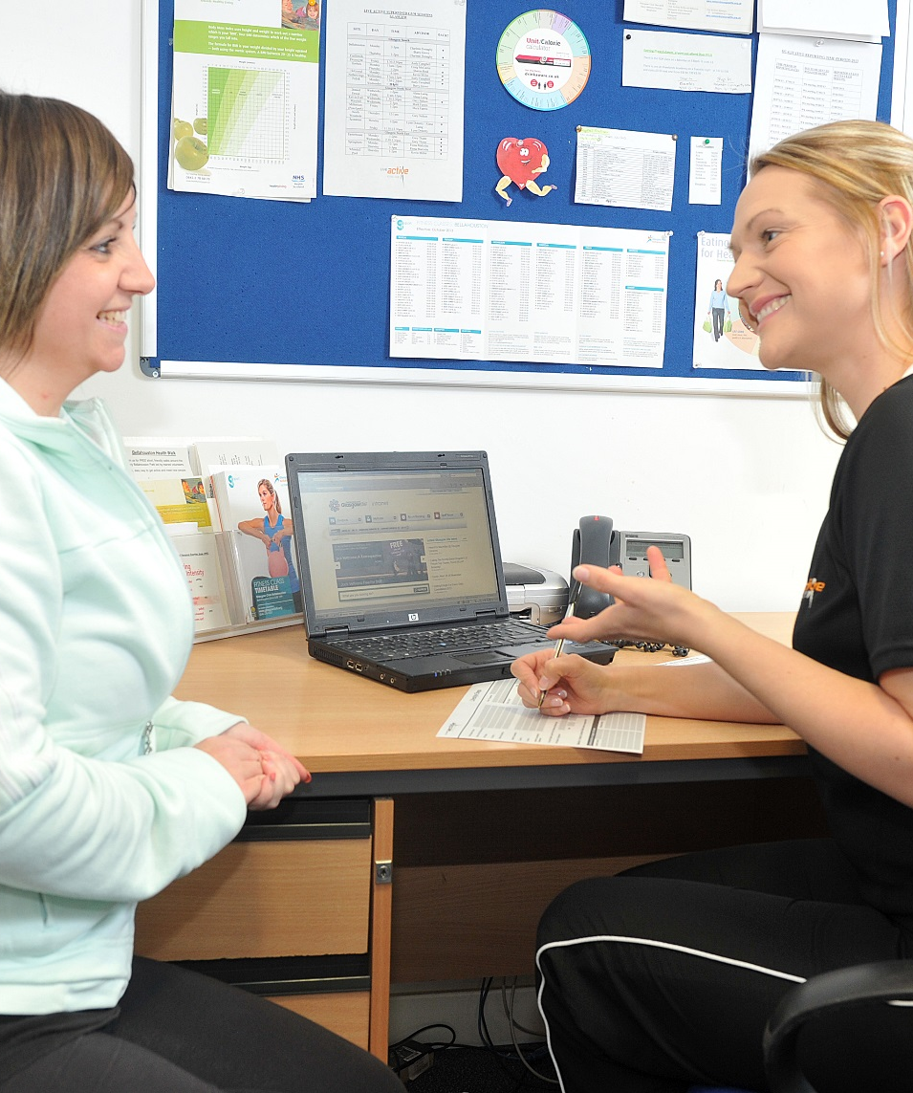
Glasgow Exercise Referral Scheme
the beginning of our lean six sigma improvement journey

Slide 2
Introduction
Glasgow Sport currently delivers the Live Active Exercise Referral scheme
Part funded by NHSGGC and also delivered across:
  East Renfrewshire, East Dunbartonshire, West Dunbartonshire, Renfrewshire and Inverclyde
Glasgow is starting a Lean Six Sigma project aiming to:
  Improve the current scheme processes and delivery model to increase its effectiveness in meeting the needs of those who live in our most deprived areas and therefore contributing to the reduction of health inequalities

Slide 3
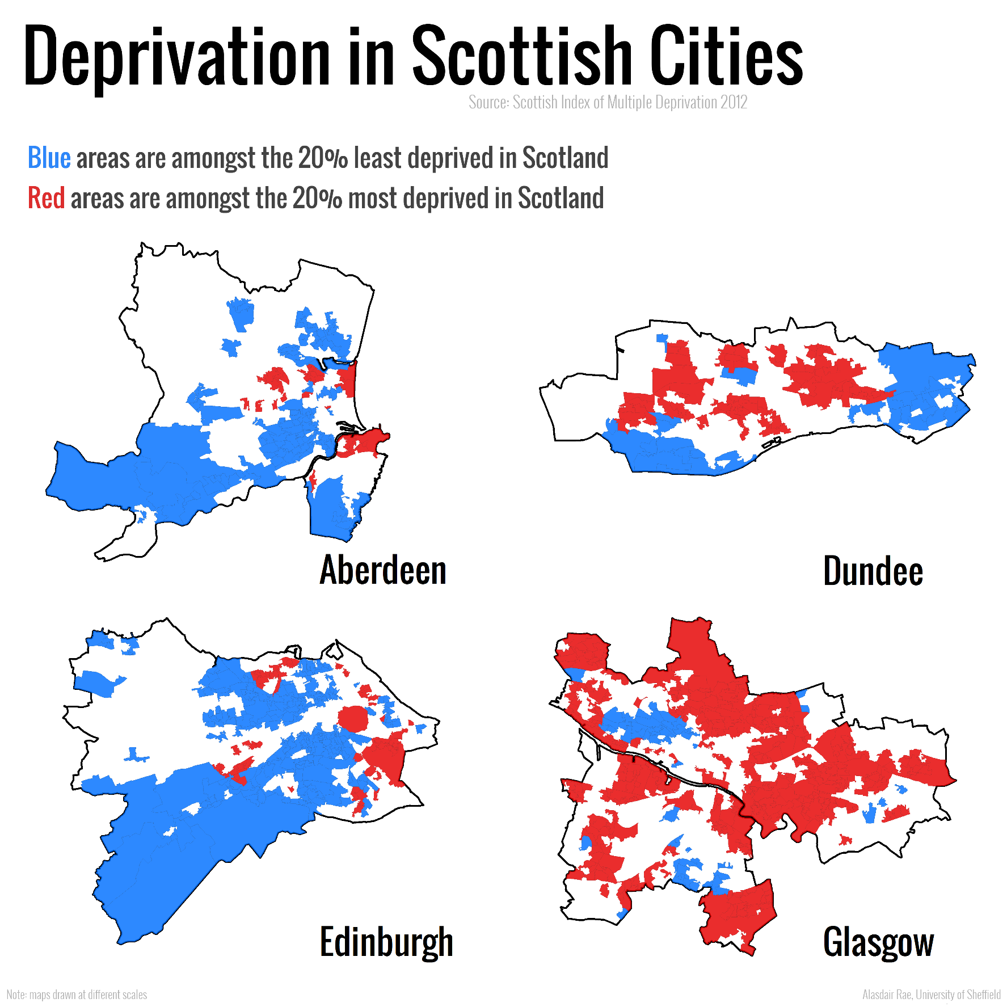

Context
Living in poverty is known to be damaging for health and one of the main causes of poor health and health inequalities
48% of the Glasgow city population live in SIMD 1, rising to 62% in the NE of Glasgow. Neighbours East Dunbartonshire have 3% of residents living in SIMD 1
Life expectancy at birth in Glasgow is lowest in Scotland:
71.6 for Glaswegian males compared to Scottish average of 76.8 yrs
78 years for Glaswegian females compared to Scottish average of 80.9 yrs

Slide 4
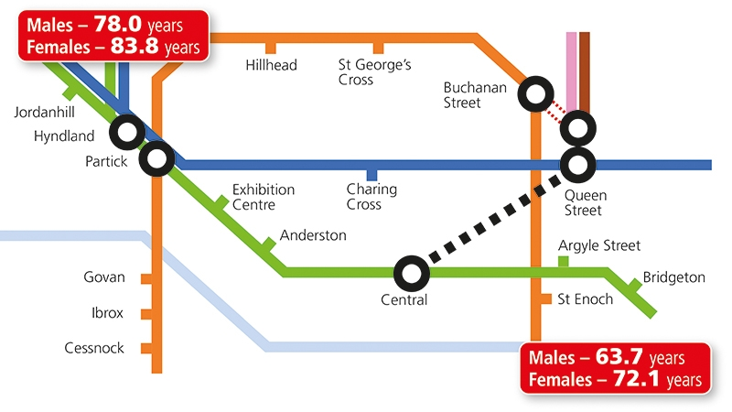
West Glasgow vs East Glasgow
Glasgow vs Scotland
71.6 years for males in Glasgow VS
76.8 in Scotland
78 years for females in Glasgow VS
80.9 in Scotland

Slide 5
Current Model
Referrals accepted from GP’s as well as wider health care providers ie pharmacists, practice nurses, community rehab
Is open to anyone 16+ who is currently inactive and would benefit from increasing their physical activity levels
12 month exercise referral scheme
1:1 behaviour change consultations at Baseline, 2 week, 1 month, 3 month, 6 month & 12 month (= 3.5hrs support over 1 year)
Advisors signpost participants into supervised gym sessions, vitality (LTC’s), mainstream classes or third party community based sessions.
4 weeks free membership with unlimited access to all classes, gyms & pools
8 FTE advisors delivering across 13 venues

Slide 6
How it’s currently performing
2993 referrals received in 17/18 (equates to approx 374 referrals per advisor)
1979 attend first appointment (66% of those referred) (*82%)
722 attend 6 month appointment (36% of those attending baseline) (*54%)
349 attend 12 month appointment and complete scheme (18% of those attending baseline) (*36%)
So why can’t Glasgow achieve the same rates as ED, with the same model?
Poor performance? OR
Is the current model not as effective as it could be in reaching and retaining those in our most deprived areas?
* East Dunbartonshire performance

Slide 7
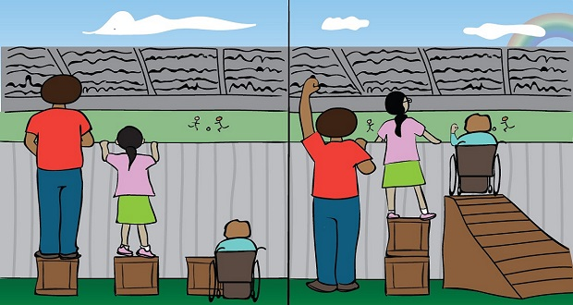
What works to reduce inequality?
NHS Health Scotland recommend a host of actions that can be taken to help reduce inequality:
Services are planned in line with proportionate universalism
Resources are re-allocated from interventions that are not effective to those focused on reducing health and social inequalities.
Services are targeted at high risk individuals with intensive, tailored support.

Slide 8
Pilot – 12 week intensive programme
Worked with Crail street practice in Parkhead which is one of the most deprived neighbourhoods in Glasgow.
17 people recruited through practice
12 week programme consisting of:
    Initial info session & consultation in the practice
    weekly workshop covering topics such as goal setting, decisional balance, coping with relapse delivered
    closed group activity class
    walking challenge & weekly step count (walk the North Coast 500)
    Health walk established leaving from practice & led by pharmacist

Slide 9
Results

Slide 10
Resource requirements
If the 17 Crail st patients engaged in the current scheme they would have each received 2.5 hours of 1:1 support over 12 weeks.
    This would have taken up 42.5 hours of advisor contact time (17 participants x 2.5hrs each = 42.5 hours)
As part of the 12 week programme participants could each receive 19 hours of group support over the 12 weeks.
    This took up 26.5 hours of advisor contact time (12 x 1.5 hr session per week + 17 x 30min baseline = 26.5 hours)

Slide 11
So why lean six sigma?
It enables us to:
Focus on the customer
Identify & understand how the work gets done
Manage, improve and smooth the process flow
Remove non value added steps and waste
Manage by fact and reduce variation
Involve and equip the people in the process
Undertake improvement activity in a systematic way

Slide 12
5 step Lean Six Sigma process
Define
Measure
Analyse
Improve
Control

Slide 13
Step 1: Understanding participant requirements
In order to understand what is really important to the customer we used this exercise to help bring the most important requirements to the fore.
Exercise:
Jim is a 50 year old man from Dalmarnock who has not taken part in activity since secondary school. He is a casual labourer being paid less than minimum wage (cash in hand) and moves from short term job to short term job. His doctor has noticed he’s gaining weight and it’s now restricting his mobility. Jim knows he has to be more active but he has no interest in using a gym and has never been in a leisure centre.
Q. What would an effective exercise scheme look like for Jim?

Slide 14
Jims requirements
Flexible settings for both consultations and exercise
Flexible support including the capacity to offer weekly or twice weekly support if required
Flexible duration of scheme for different groups if required
Skilled and knowledgeable advisors
Clear information on the scheme prior to engaging
Timeliness of programme, particularly between referral and baseline
Wide variety of options & activities based on participants individual goals
Affordable and/or free long term activity

Slide 15
Next steps
Check requirements with existing participants referred from SIMD1 areas
Analyse previous SIMD1 participant completer data to better understand journey.
Narrow the focus into more manageable project. Prioritise requirements that are most important and/or give biggest return on time/resource.

Slide 16
Questions ?

